Slide 1


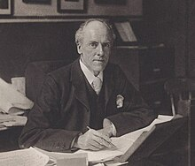
Why Statistics?
Without data you are just another person with an opinion – W Edwards Deming (Data Scientist)
It is easy to lie with statistics, it is easier to lie without them – Frederic Mosteller (Statistician)
Statistics is the grammar of science – Karl Pearson (Statistician)

Slide 2
Simpson’s Paradox
A trend that appears in different groups of data disappears or reverses when the groups are combined
Example: Between 2000 and 2013, the US median wage went up by about 1% in real terms (i.e. adjusted for inflation)
Yet:
Group by Education Level | Change in wages
< High school | -7.9%
> High school | -4.7%
Attended University, but no Degree | -7.6%
Degree holders | -1.2%

Slide 3
Simpson’s Paradox
Explanation: Median wage of people with degree went down, but the number of degree holders went up considerably
Example: Population size = 11
To calculate median: 5 5 5 10 10 10 15 15 15 20 20 … Median = 10
Group by Education Level | Annual Wages | Count
< High school | Rs 5 | 3
> High school | Rs 10 | 3
Attended University, but no Degree | Rs 15 | 3
Degree holders | Rs 20 | 2

Slide 4
Simpson’s Paradox
Headline: The national median wage has gone up by Rs 4
Reality: For each group, average wage has declined by Rs 1
Next year, the government made a lot of effort to put more students through high school and university, but the average wage of each group fell by Re 1
Modified data: Population size = 11
To calculate median: 4 4 9 9 14 14 19 19 19 19 19 … Median = 14
Group by Education Level | Annual Wages | Count
< High school | Rs 4 | 2
> High school | Rs 9 | 2
Attended University, but no Degree | Rs 14 | 2
Degree holders | Rs 19 | 5

Slide 5
Simpson’s Paradox – Another Example – Surgery Rate Success at a Hospital
Group 1 (Young patients):
Hospital A: 90 successful surgeries out of 100 (90% success rate)
Hospital B: 19 successful surgeries out of 20 (95% success rate)
Group 2 (Elderly patients):
Hospital A: 10 successful surgeries out of 100 (10% success rate)
Hospital B: 2 successful surgeries out of 10 (20% success rate)
Combined Data:
Hospital A: 100 successful surgeries out of 200 (50% success rate)
Hospital B: 21 successful surgeries out of 30 (70% success rate)

Slide 6
Data Analytics

Slide 7



Current and Historical Data
Transaction ID | Card Number | Amount | Merchant | Time | City
1 | 1234 | 4500 | AB Hotel | 13.50 | Pune
2 | 5678 | 817 | PQ Petrol Pump | 08.23 | Mumbai
3 | 9012 | 9092 | RS Shop | 15.21 | Chennai
4 | 1890 | 345 | TM Store | 10.03 | Hyderabad
..
..
99999999 | 5632 | 82000 | Amazon.in | 19.11 | Pune
100000000 | 8971 | 100 | Subzi.com | 09.36 | Bangalore

Slide 8

Using Data
Valid transaction?
Invalid transaction?
Amount range: 1-5000
Time: Morning
City: Pune
Reason: Shopping
Amount range: 5001-10000
Time: Afternoon
City: Mumbai
Reason: Hotel
Clusters
Amount range: 10000-25000
Time: Evening
City: Delhi
Reason: Bill Pymt
Amount range > 25001
Time: Night
City: Other
Reason: Online

Slide 9



Operational Data (Data Comes In)
An account holder transfers money
A customer places an order
A loan is granted

Slide 10
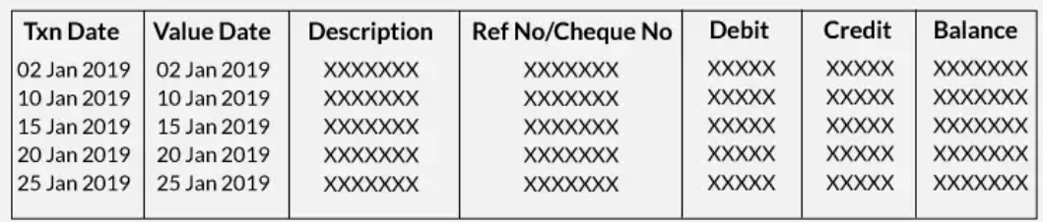
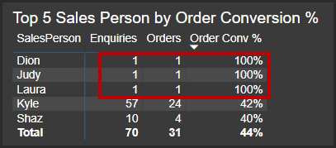
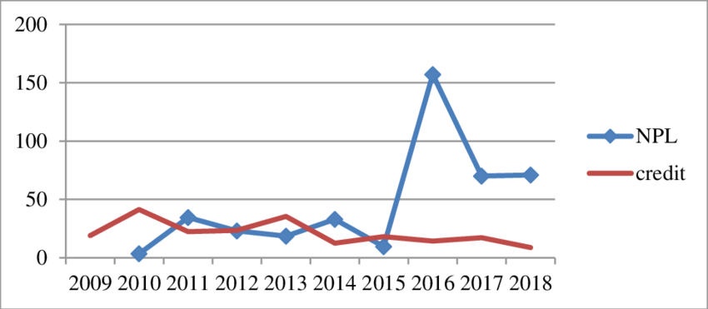
Analytical Data (Data Goes Out)
Last month money transfer history
Top 5 order conversions
Loans report

Slide 11



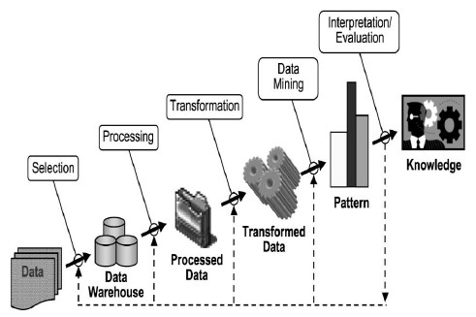
Data Warehousing to Data Analytics
CRM
Reporting
Data
Warehouse
Billing
E
T
L
Analytics
ERP
External data
Mining

Slide 12
Areas of Data-related Work

Slide 13
Data – What is There for Me?
Data
Engineering
(Infrastructure)
Data
Analytics
(Decisions)
Data
Science
(Modelling,
Product building)

Slide 14
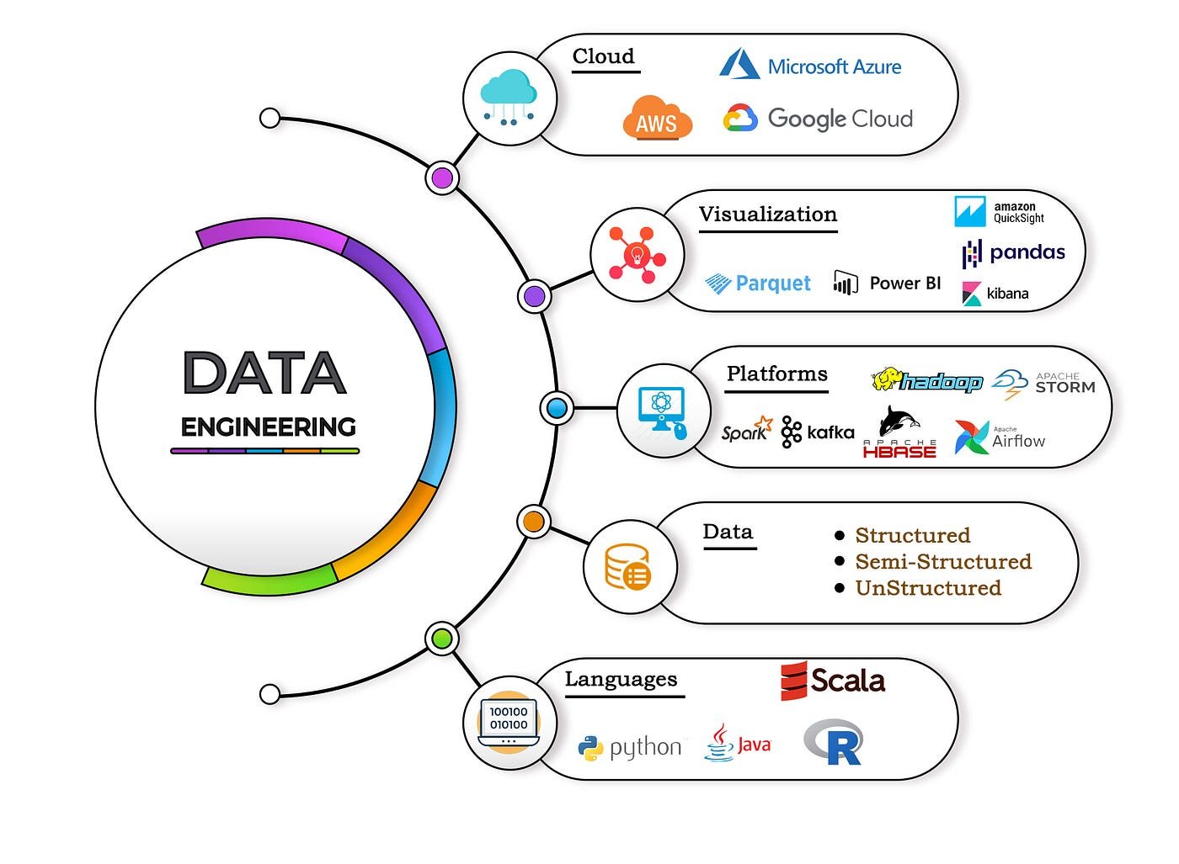
Data Engineering
Focus: Creating and maintaining infrastructure for Data Analysts and Data Scientists
Skills: Programming (Python/R), Apache Spark, Kafka, Databases (SQL/MongoDB), Linux Shell Scripting, Cloud (AWS), DevOps (Docker, Kubernetes, Jenkins, Git), ETL

Slide 15
Data Analytics
What happened?
What were the sales figures?
How many users registered?
How many subscriptions got cancelled?
Why did it happen?
Which products were sold the most?
Did we have more mobile users?
Did cancellations happen after watching a particular movie?
What is likely to happen?
What will the sale be in this quarter?
How many total users will we have?
Will subscription cancellation rate drop to 10%?
What action should we take?
How do we grow sales?
How do we get to 1M users?
How do we take the subscription cancellation rate to 5%?

Slide 16
Types of Data Analytics
Optimization, Decision trees
Descriptive analytics (Hindsight)
Diagnostic analytics
Predictive analytics (Insight)
Prescriptive analytics (Foresight)
Prescriptive Analytics
What is the best action?
Predictive Analytics
What will happen in the future?
Diagnostic Analytics
Why did it happen?
Forecasting, Data mining, Regression, Simulations
Descriptive Analytics
What happened in the past?
Dashboards, Business intelligence

Slide 17
Data Analytics Types
Type | Description | Examples
Descriptive | The use of data to understand past and current business performance and make informed decisions | Which product had the maximum ups and downs in sale last year? Which students scored very high or very low marks?
Diagnostic | Why something happened? | How much salary should we offer to this prospective employee? (Regression analysis)
Predictive | Predict the future by examining historical data, detecting patterns or relationships in these data, and then extrapolating these relationships forward in time. | Predict whether a customer will churn at HDFC Bank, Predict next year sale for Walmart
Prescriptive | Use optimization to identify the best alternatives to minimize or maximize some objective | Maruti Suzuki should manufacture x SUVs, y hatchbacks, z commercial vehicles every three days to maximize its profit

Slide 18
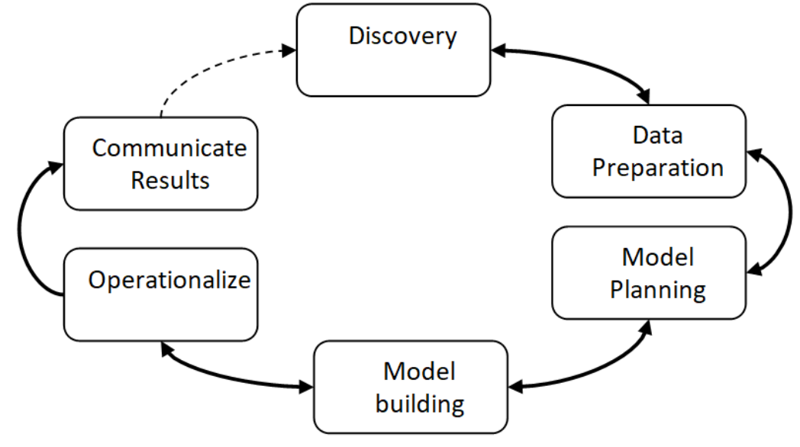
Data Analytics Life Cycle

Slide 19


Data Science
Focus-1: Advanced statistical modelling (e.g. Machine learning, Time series analysis, Decision tree-based techniques, Bayesian networks, etc) – Focus is always on the future
Focus-2: Build data products

Slide 20
Python Data Analytics/Science: NumPy, Pandas, MatplotLib, Seaborn, ScikitLearn (SkLearn)

Slide 21
NumPy
NumPy: Base for everything in Python Data Analytics
Python library for creating N-dimensional arrays
Similar to Python lists, but much more efficient
Ability to quickly broadcast functions (No need to do element-by-element operations on arrays)
Example:
arr = np.array([1, 2, 3, 4])
scalar = 10
result = arr + scalar
Built-in linear algebra, statistical distributions, random number capabilities

Slide 22
NumPy Arrays
Main ways of creating a NumPy array:
Transform Python list
Use built-in functions
Generate random data
Indexing and Selection: Single element, Slicing, Broadcasting, 2D indexing and selection, Conditional selection
Operations on arrays: Arithmetic, Universal functions, Summary statistics, 2D arrays
Code: C:\code\Data Analytics\numpy

